Slide 1
English & Chess

Slide 2
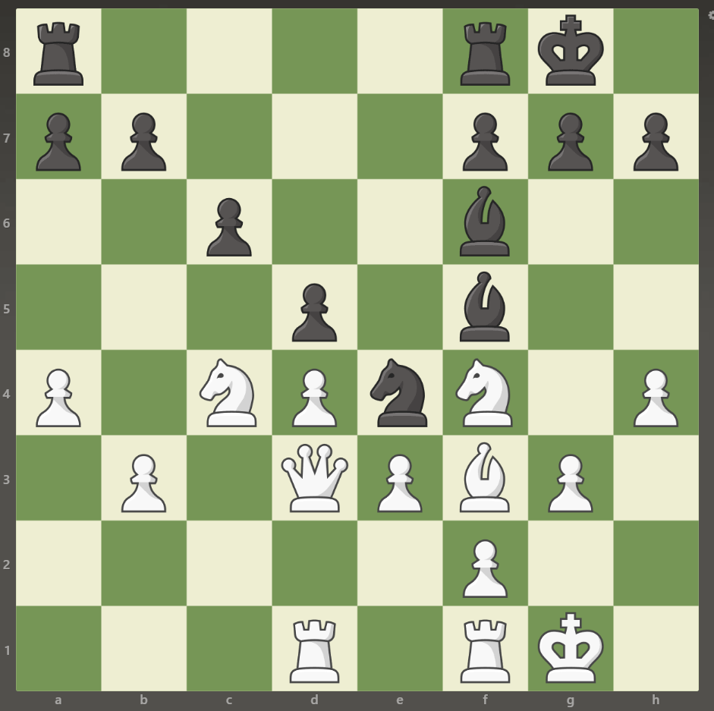
How many pawns are there on the 7th rank?

Slide 3
How many pawns are there on the 7th rank?
There are 5 pawns

Slide 4
How many pawns are there on the 2nd rank?

Slide 5
How many pawns are there on the 2nd rank?
There is one pawn

Slide 6
How many rooks are there on the d-file?

Slide 7
How many rooks are there on the d-file?
There is a rook

Slide 8
How many kings are there on the board?

Slide 9
How many kings are there on the board?
There are 2 kings

Slide 10
How many queens are there on the board?

Slide 11
How many queens are there on the board?
There is a queen

Slide 12
How many knights are there on the 4th rank?

Slide 13
How many knights are there on the 4th rank?
There are 3 knights

Slide 14
How many bishops are there on the f-file?

Slide 15
How many bishops are there on the f-file?
There are 3 bishops

Slide 16
THE END

